Slide 1

Reminder:
CA2 Assignments are due during your tutorial class.
Softcopies should be uploaded to the IVLE CA2 folders.
EXAM: 2 parts.
Part a) select 2 short answers ( 1.5 pages each) from 5.
25 marks each.
Part b) 1 ‘essay’ response. (choice of two) 50 marks.
OPEN BOOK – lecture notes and readings permitted.

Slide 2

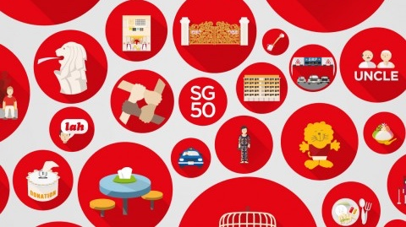
SG’s Business History
Icons and Heritage
Dr. Donna Brunero
GES1009/SSA2203

Slide 3
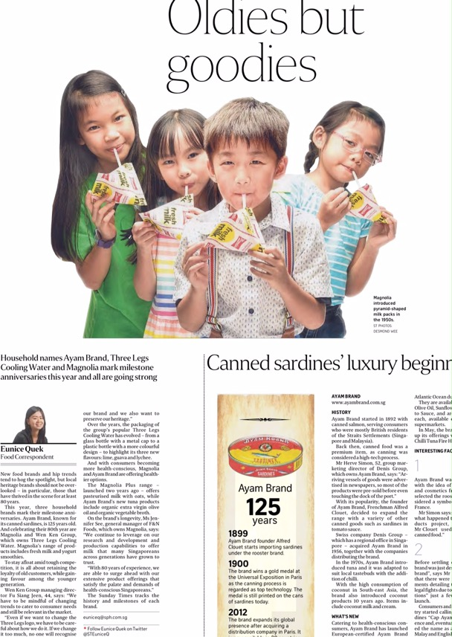
The Sunday Times, 26/3/2017

Slide 4
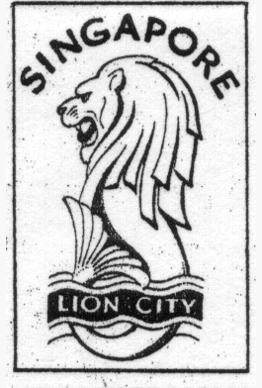
Icons and heritage branding: Focus Questions
What makes a heritage brand or local ‘icon’?
What role do businesses have in shaping our awareness of local or heritage brands?
Can thinking about national history and local identity provide us with insights into Singapore’s business history?

Slide 5
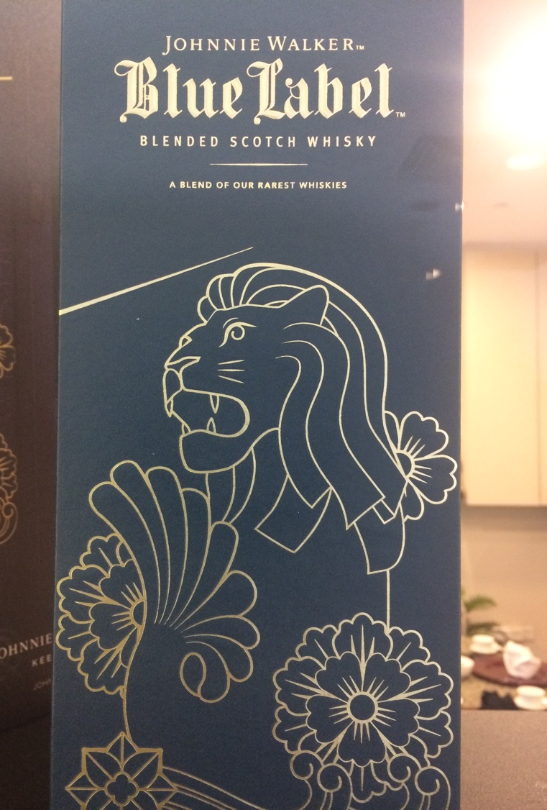
Outline:
Heritage and Icons in the Singapore context.
Case studies:
F&B: Ya Kun and Old Chang Kee
Raffles Hotel & the Singapore Girl (SIA)

Slide 6

Singapore’s Heritage and local brands…
Often aligned with nation building ideals (cultural values, identity, shared memories).
Tourism-oriented schemes (Tourist Board campaigns): Instant Asia (1966), Surprising Singapore (1977), New Asia Singapore (1996), Uniquely Singapore (2004) to Your Singapore (2010)
Brands and business identified as having a long history and of representing something distinctly Singaporean…
Local products are often a fusion of goods from the region with some ‘local items

Slide 7
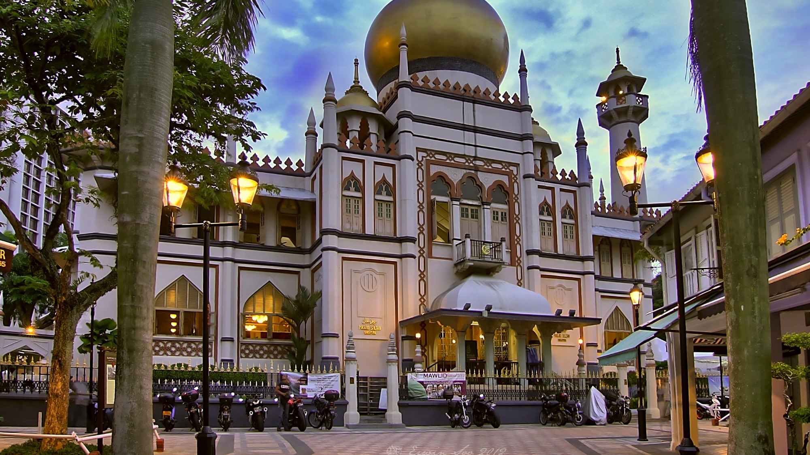
Business and Heritage
Interest in preserving ‘vanishing trades’
Promotion of ‘distinctly Singaporean’ businesses and brands
The idea that conservation and preservation of ‘shared heritage’ is important.
Example: the creation of heritage precincts- China town, Little India, Kampung Glam & Arab Street, the Civic district

Slide 8
Criticism?
Not enough is being done to preserve heritage and trades.
A Disneyfication of some places:
Chinatown? (who is Chinatown preserved for?)
Urban renewal – shophouses as boutique hotels…but what about the former businesses and owners?

Slide 9
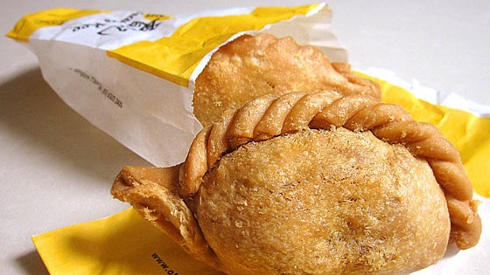
Old Chang Kee
Original founder: Chang Swang Boon, a Hainanese migrant.
Origins in 1956, with a stall set up near Rex Cinema in Mackenzie Road.
“The pastry tastes perfectly good rolled out with a [beer] bottle, why change?”
Chang Swang Boon

Slide 10
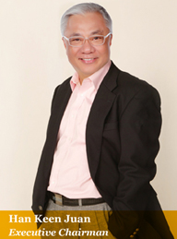
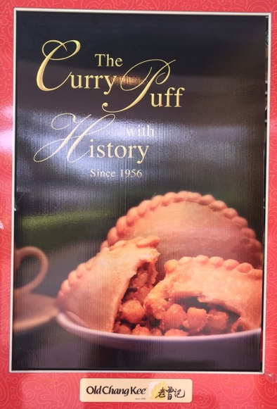
Old Chang Kee
Current owner: Mr. Han Keen Juan bought the business in 1986. This marked ‘new beginning’ for Old Chang Kee.
Modern production methods
First retail outlet: 1995
Old Chang Kee places emphasis on being a heritage brand that Singaporeans have grown up with.
Challenges: Quality control -- Franchises overseas were closed in 2002.
2004 Company expansion to outlets: Australia, Indonesia, Malaysia, UK.

Slide 11
Old Chang Kee & Heritage
“For over half a century, Singaporeans from all walks of life have enjoyed Old Chang Kee's delectable hot snacks and lip-smacking quick bites. We embrace the wonderful traditions and noble heritage of our proud nation, and will always strive to be your Old Chang Kee, bringing you the good old tastes that we have all come to love since 1956.”
Old Chang Kee website. http://www.oldchangkee.com

Slide 12

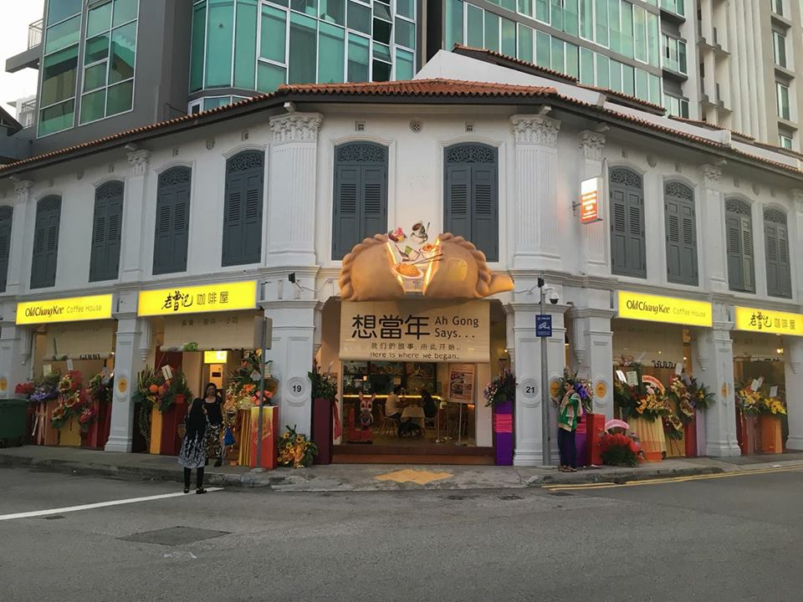
2018: Rex Cinema area, MacKenzie Road…near the site of the very first Old Chang Kee.
https://discoversg.com/2018/05/17/old-chang-kee-flagship/

Slide 13
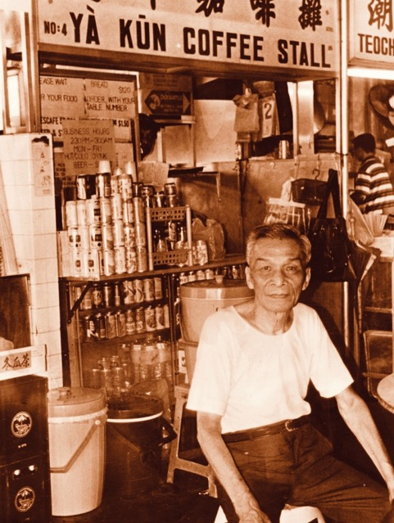
Ya Kun
Loi Ah Kun, A Hainanese, Arrived in Singapore in 1926 and took up an apprenticeship at a Hainanese coffee shop…by 1944 Ya Kun was established.
In the company history it is Mr Loi’s wife who is credited for coming up with the idea of homemade kaya spread on toast…
The business moved rom Lau Pa Sat (Telok Ayer market) to Far East Square.
Ya Kun is still a family run business
A household name that has expanded overseas

Slide 14
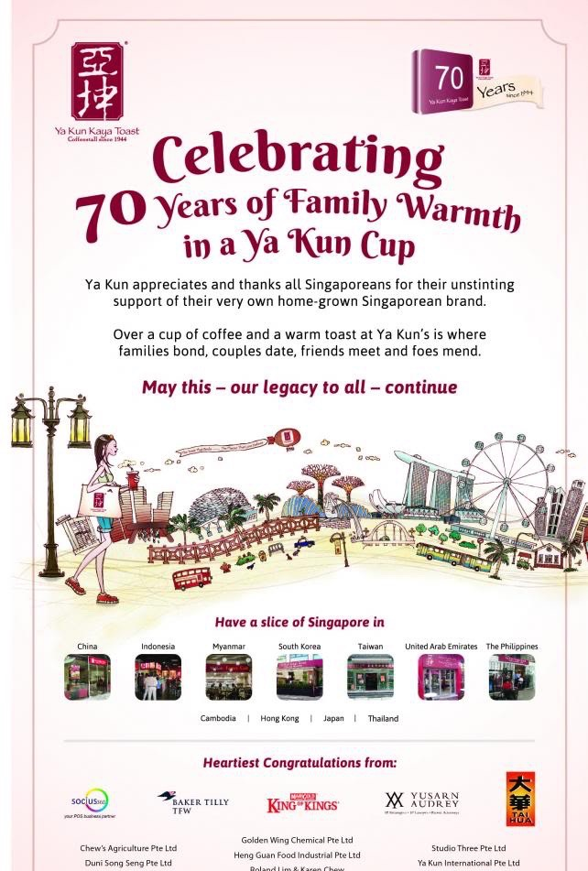
“Ya Kun symbolizes the early days of Singapore, when collies and hardworking immigrants from China toiled at the ports and trading houses to build not just a fortune for themselves but also to turn Singapore into a bustling trading post of the British Empire”
William Koh, The Top Toast: Ya Kun and the Singapore Breakfast Tradition, (2015)

Slide 15
Ya Kun: innovations?
Ya Kun factory (Bedok): producing kaya
Move to a chain of mass market ‘retro-ambience’ cafes (the first ‘kopitiam’ to do so)
Franchising
Branching overseas: China, Hong Kong, Cambodia, Indonesia, Japan, Thailand, United Arab Emirates among others…
Ya Kun family café concept.

Slide 16
Ya Kun: challenges?
Rise of other types of coffeeshops/cafes: Starbucks, Coffee Bean & Tea Leaf
Rise of rival kopitiams: Killiney Kopitiam, Wang Café, Toast Box

Slide 17
Ya Kun:
A close link between the brand and SG heritage.
The idea of a founding figure and a ‘rags to riches’ story
A family firm but with the inclusion of professional manager
Strong branding “ The toast that binds…Kinship, Friendship and Partnership”

Slide 18
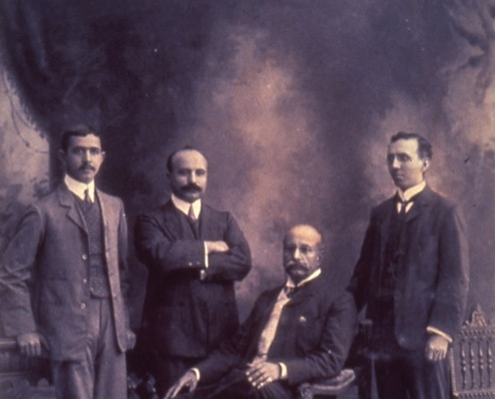
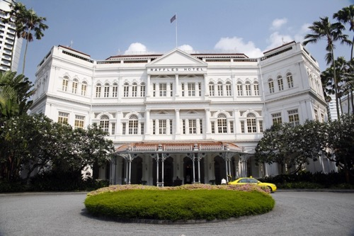
Raffles hotel
(1887-present)
The Sarkies Brothers as key figures in the history of Raffles Hotel.
Deemed a ‘heritage hotel’ and an icon with a history that ‘tells the history of Singapore’.
Subject to extensive renovations in the early 1990s (with further renovation this year).
A restored Raffles Hotel as a sign of the ‘sensitive and artistic’ side of a global city?
Part of the Accor Group.

Slide 19
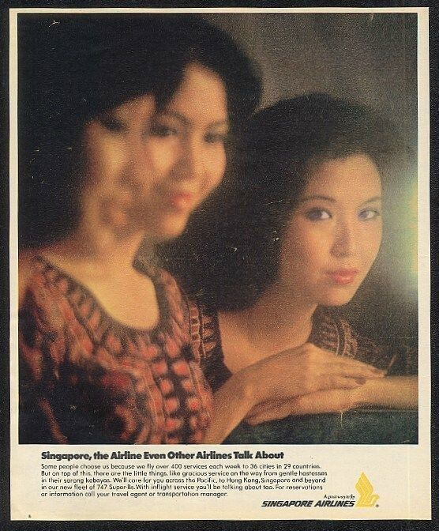
Singapore Airlines and the Singapore Girl
Batey Ads (Ian Batey)
1972: Creation of the iconic ‘Singapore Girl’
Discussion: “Singapore Girl Still Current says SIA”
https://www.channelnewsasia.com/news/singapore/singapore-airlines-sia-singapore-girl-branding-11190376

Slide 20
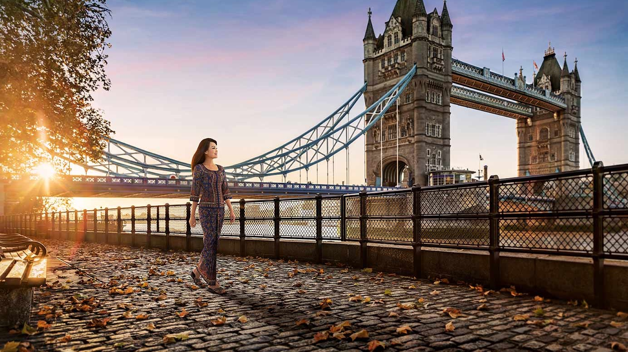

Slide 21
Further reading:
http://www.straitstimes.com/singapore/fun-facts-about-made-in-singapore-products
http://www.straitstimes.com/business/singapores-raffles-hotel-a-look-at-the-iconic-landmark-through-the-years
http://www.channelnewsasia.com/news/singapore/the-symbol-of-singapore/2218770.html
https://www.chefatwork.com.sg/2017/06/02/growing-stunning-singapore-heritage-brands-and-food/
Books and articles by:
Brenda Yeoh and Lily Kong on heritage and memory in Singapore.
Huang Jianli and Hong Lysa on national histories.

